Slide 1
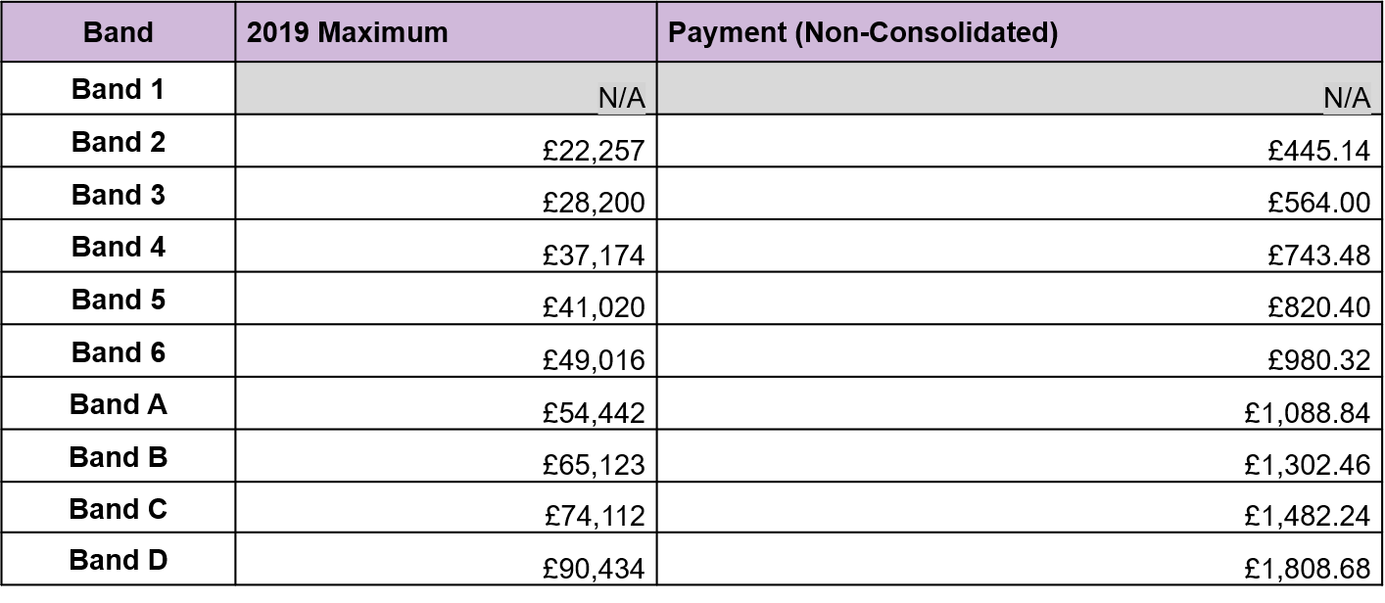
A 2% Non-consolidated and pensionable payment for staff on pay band maximum
These changes primarily benefit:
Those not in receipt of pay progression as at 31 March 2020 due to being at the top of their band.

Slide 2
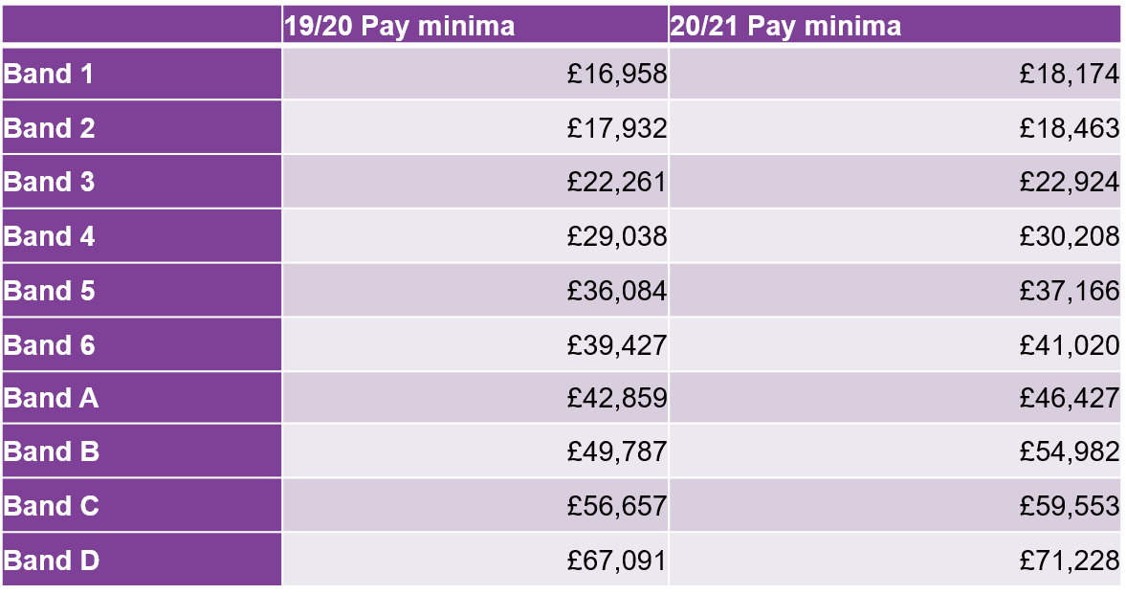
New 20/21 Pay Band Minima After removal of all minimum points from Pay Bands (plus step 2 in Band A and B)
These changes primarily benefit:
Those not eligible for pay progression as at 31 March 2020 due to being in band <6 months;
Those new starters who joined since 1 April 2020 as they will get uplifted to the new minima;
Those who have recently been promoted to a new band as they will get uplifted to the new minima in their band (if they joined at the minima).

Slide 3
Changes to Pay Band 1
To note:
All staff in Pay Band 1 as at 31 Mar 20 will be moved to a spot rate of £18,174;
The minima will be removed as per the previous proposal, and the remaining step will be revalorised up to £18,174;
Staff that were already at the top of Pay Band 1 at 31 March 2020 will not be eligible to receive the non-consolidated payment, as the revalorisation represents at least a 2.3% increase for those at the maximum of pay scale.

Slide 4
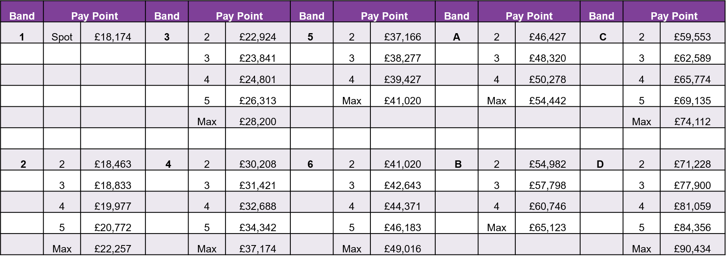
New pay scales from 1 April 2020
To note:
All pay band minima removed (thereby making the 19/20 year PB step 2 the new minima);
Pay Band A and B step 2 also removed.

